Slide 1
Using Genetic Algorithms as a Tool of Iteration of Finite State Machine Behaviors in Video Games
proposed by:
Claudiu Ioan Maftei
Scientific Coordinator:
Prof. Dr. Henri Luchian

Slide 2
Contents
Motivation & Context
Research Goals
Research Method
The Game
The Engine
Finite State Machines
Comparisons (...)
FSM Editor
Genetic Algorithms
Creating a GA for FSMs
Running the Experiment
Conclusions
Future Work

Slide 3
1. Motivation & Context
Video Game Agents
Entities defined by their ability to perceive and change their environment
Unlike more common varieties of AIs, the goals of video game agents are phenomenologically inclined
Enemy NPC Behavior Design
NPC = non-player character
Intelligent behavior does not equal fun behavior (for the player)
FSMs are a common used technique for modelling Enemy NPC behavior

Slide 4
2. Research Goals
What is the manner in which genetic algorithms can be used to evolve FSM behaviors?
What are the manners in which the above-proposed technique can be useful, if at all?
What differentiates a human-designed behavior from a computer-designed one?

Slide 5
3. Research Method
Developed a top-down shooter game
Its enemy agents are controlled by FSMs
Developed a method of encoding and decoding FSMs into genes
Found a crossover operator that works on FSMs
Experimented with the parameters of the GA as to reach the conclusions answering the before-mentioned questions

Slide 6
4. The Game
2D Top-down ¾ shooter
Pixel-art styled
OOP and Event-based programming
Various design patterns (factory, decorator, listener etc.)

Slide 7
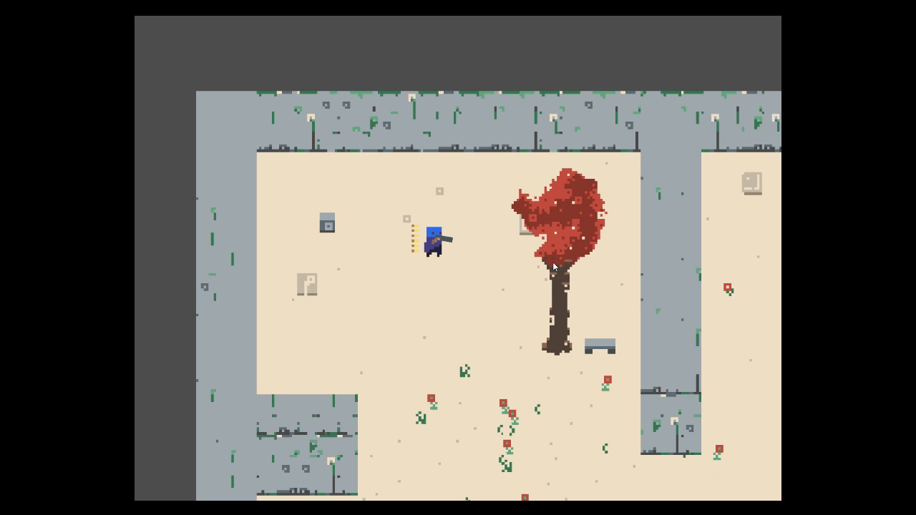

Slide 8
5. The Engine
Godot 3.1
Open-source
GDScript language – high-level dynamically typed
Can be used as a pure 2D engine
Light-weight (~51 MB)
Able to create custom tools for
Fast to build a prototype in

Slide 9
5. The Engine
Tree-Architecture
Each node has its own script and (inheritable/extendable) properties
e.g. : sprites, kinematic bodies, audio streams, viewports etc.
Each node is considered to own the nodes of its subtree, thus changes to the position, visibility, and other variables, of the owner also apply to the whole subtree
Scenes
Nodes that are packed together and runnable in the game

Slide 10
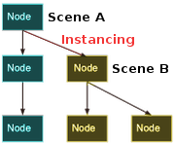

Slide 11
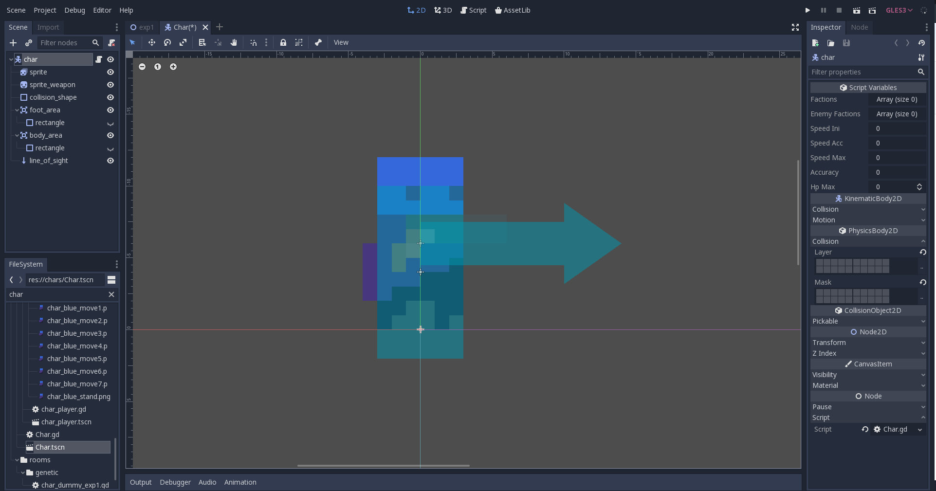

Slide 12
6. Finite State Machines
States
Assert control over the agent
Their specific behaviors feature event-based programming
Used states: aiming, approaching, shooting, standing still
Transitions
Transferring the property of “activeness” from one state of another
Used transitions: on-done (state signals it is done), on-cooldown (a timer runs up)

Slide 13
7. Comparisons with Other Forms of Behavior Decision Algorithms
(Random) Decision Trees
Inner nodes = decision points
Leaves = behaviors
RDTs is history-agnostic, meaning that previous states are unable to affect the current one outside the means offered by the behavior itself
Highly-modular nature benefits simple designs, but shows risk of convolution on complex and/or conditional behavioral patterns
A Genetic Programming approach has been developed for the issue of evolving RDTs for enemy agents (see Related Works)

Slide 14
7. Comparisons with Other Forms of Behavior Decision Algorithms
Goal-Oriented Action Planners & Hierarchical Task Networks
Solving problems through chaining a list of actions, each with prerequisites and effects
GOAPs and HTNs are proactive – given a world-state, they find a possible sequence of actions to reach the desired world-state; unlike FSMs, which are reactive
GOAPs and HTNs lead to high emergence (i.e. complex states generated by simple rules), which may work both in the favor and disfavor of the designer’s intended experience
It can be considered rule-based programming for the sake of GAs (see Related Work)

Slide 15
8. Finite State Machine Editor
Used to generate FSMs from a node tree (visually represented)
[tool] keyword enabling running the code in the editor, outside of the compiled game – favoring custom tool tailoring
File system – instantiation, naming, moving of nodes on a scene
Property dictionary overwritten as to export in the editor the parameters of the state/transition types

Slide 16
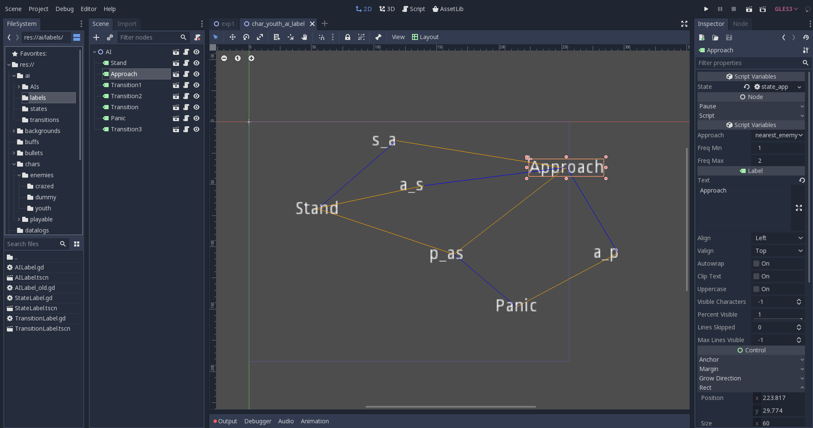

Slide 17
9. Genetic Algorithms
Metaheuristics; solving optimization problems
Solution/phenotype encoded in a chromosome/genotype
A population of randomly chosen solutions is generated
Based on their closeness to the desired solution (i.e. fitness), some of the solutions are further selected to breed new solutions
Genetic operators are applied: usually crossover (exchange of genes between two chromosomes) and mutation (modification of individual genes)
The process is repeated until the desired termination condition is met

Slide 18
10. Creating a Genetic Algorithm for FSM Behaviors
Encoding/Decoding
Each chromosome is an array of dictionaries
Each dictionary contains the defining properties of its state/transition:
Name of the node (so that it can be further referred to)
Whether it is initial (in the case of states)
Its type
Array of other parameters
Cvasi-homogeny – all components are represented in the same manner, as not to have a different gene containing the initial states, or different dictionary keys for different parameters
It is not actual homogeny, as only a single genetic operator is agnostic to each gene’s phenotype-expression

Slide 19
10. Creating a Genetic Algorithm for FSM Behaviors
The Continuity Problem
Transitions are dependent on the states they refer to
The position in the array does not hold any value for the phenotype (unlike vanilla GA variations)
Chromosomes are of varying length
Application of genetic operators should not function alike a randomizer – it should be able to maintain the sequences of states and transitions that lead to higher fitness

Slide 20
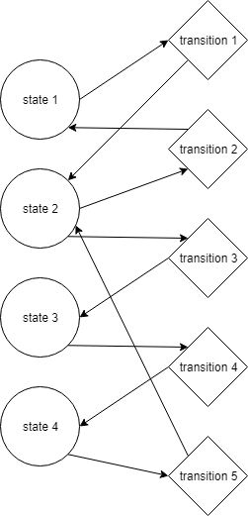
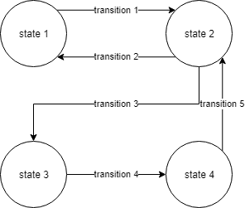

Slide 21
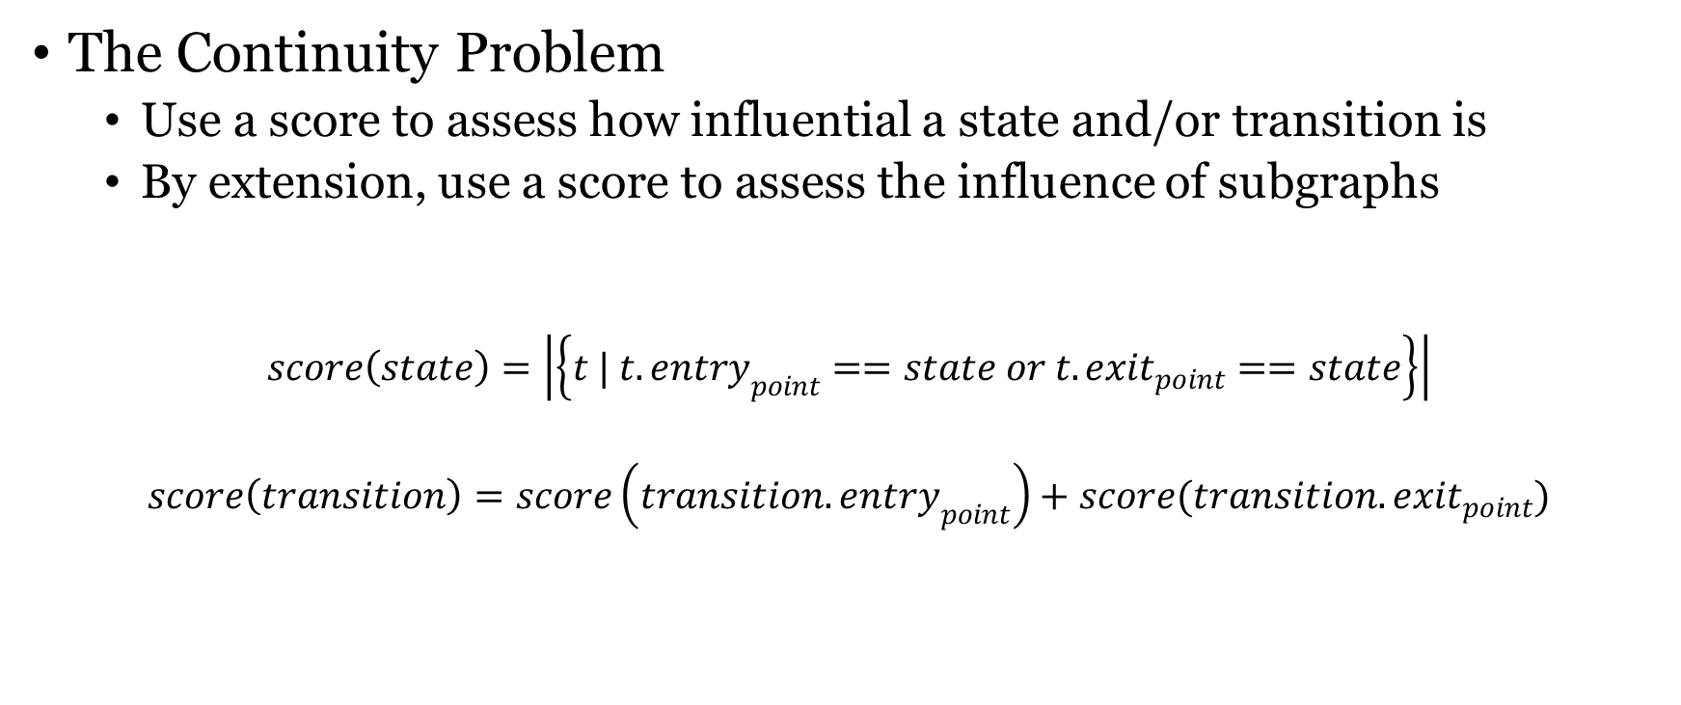
10. Creating a Genetic Algorithm for FSM Behaviors
The Continuity Problem
Use a score to assess how influential a state and/or transition is
By extension, use a score to assess the influence of subgraphs
$$score\left(state\right)=\left|\left\{t | t.entry_{point}==state or t.exit_{point}==state\right\}\right|$$
$$score\left(transition\right)=score\left(transition.entry_{point}\right)+score(transition.exit_{point})$$

Slide 22
10. Creating a Genetic Algorithm for FSM Behaviors
Crossover
Highly connected regions from each chromosome are selected based on their connectivity score (and of a size based on random chance)
They are exchanged between the chromosomes

Slide 23
transition_to_swap = [ ][ ]
elected_transition = select(transition) #based on either connectivity score or a random distribution
transitions_to_swap.append(elected_transition)
states_to_swap.append(elected_transitions.entry_point ⋃ elected_transitions.exit_point)
transitions_to_swap.append(transitions_between(states_to_swap)) #all other transitions inbetween
while(extension_chance happens): #selecting a chance-based amount of transitions/states to be swapped
t0, t1 = get_adjacent_transition(transitions_to_swap)
if t0 is null and t1 is null: break
if t0 is not null:
transitions_to_swap.append(0, t0)
states_to_swap.append(t0.entry_point ⋃ t0.exit_point)
if t1 is not null:
transitions_to_swap.append(1, t1)
states_to_swap.append(t1.entry_point ⋃ t1.exit_point)
swap_transitions()
swap_states()
add_any_remaining_states()
add_any_remaining_transitions()

Slide 24
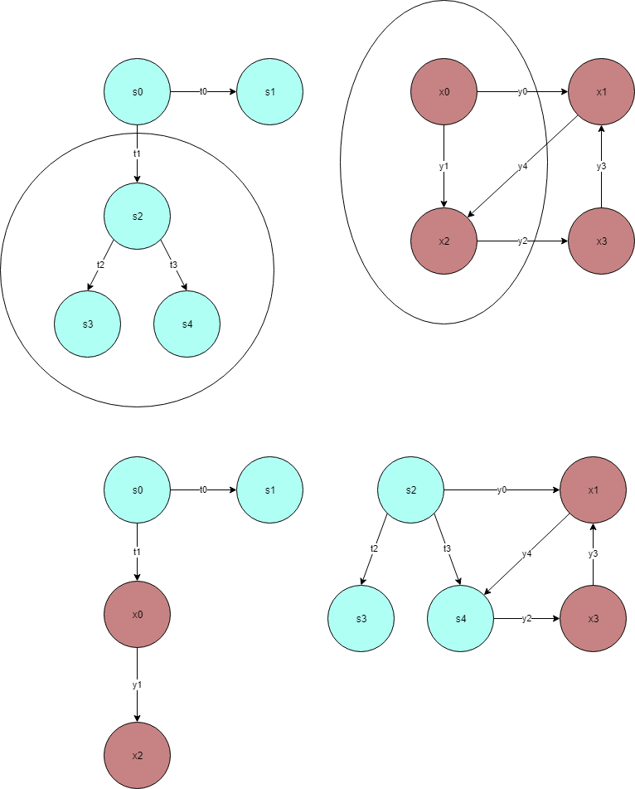

Slide 26
10. Creating a Genetic Algorithm for FSM Behaviors
Hard Mutation
FSM-scope
Addition, removal, changing of type of states and/or transitions
Changing of the transition points
Soft Mutation
State/transition-related
Changing ints (by +/-1), floats (by percentile), strings (from a individualized list of options)
Only heterogeny-blind genetic operator

Slide 27
10. Creating a Genetic Algorithm for FSM Behaviors
Non-coding Genes
Inspired by nature’s non-coding DNA, non-coding genes refer to genes that do not translate into behavior
They may be disconnected subgraphs, or subgraphs that cannot be activated
They are not removed as to contain the history of the chromosome, thus gaining both the ability of resurgent/recessive behaviors
Contain the risk of corrupting working-genes
Minimize the chance of gene deletion causing loss of desirable traits

Slide 28
11. Running the Experiment
Setup
Optimization problem: generating a behavior that deals as much damage to nearby targets
Cell-like rooms are created, each containing the necessary objects to run and assert the performance of a single individual
They are multiplied to obtain a population (that is ran concurrently)
They are reset upon entering the new generation
In the experiment, the maximum achievable fitness score is 48 (damage dealt to nearby enemies in the given 16 seconds)

Slide 29
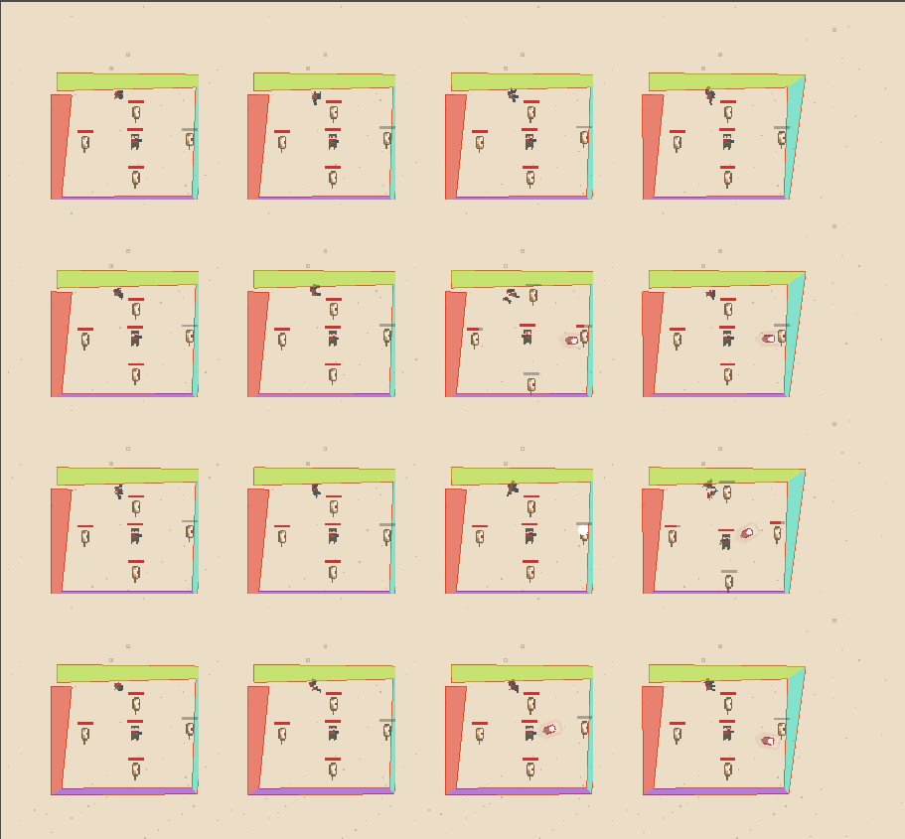

Slide 30
11. Running the Experiment

Slide 31
11. Running the Experiment
Notes
The genetic operators can produce individuals that have high fitness, but not constantly
One of the presumed reasons (turned to be true) is that the average population does not increase in fitness
A more elitist selection method was attempted

Slide 32
11. Running the Experiment

Slide 33
11. Running the Experiment
Notes
Several runs led to individuals reaching maximum fitness score (each a variation of a cycle of aiming and shooting)
An increase in average fitness is necessary to attain an increase in maximum fitness

Slide 34
11. Running the Experiment

Slide 35
11. Running the Experiment
Notes
The crossover-less variation led to worse results, as such it can be concluded that the manner in which the problem is addressed is indeed a genetic algorithm, and not a randomization-based heuristic
Mutation alone does not better the fitness of the overall population (given that sequences of states/transitions are the ones weighing the improvement)
The chance of occurrence of the precise required mutation is small
The maximum fitness does not cross the 40 line

Slide 36
12. Conclusions
Manner in which GAs can be used to evolve FSMs
Based on the previous results, it can be concluded that the presented method leads to a form of optimization that favors the characteristics of GAs as opposed to a randomized-selective heuristic
Manner in which the method is useful
In terms of generation from scratch: FSM behaviors are too incidence-dependent
The technique is useful for the iterative design process of finding behaviors that fill a certain role

Slide 37
12. Conclusions
Differences between a human-designed behavior and a computer-designed one
Non-coding genes are (usually) inexistent in human-made designs
Human designs contain less redundancy (i.e. minimized in terms of number of states/transitions necessary to attain the same behavioral sequence/result)
GAs can generate behavior sequences otherwise not thought about by the game AI designer (such as, in the case of this work, approaching the enemy while shooting for dealing the damage faster)
Given the differences, the method developed in this thesis fills the niche of exploitation of a search space, as opposed to exploration – a tool of iteration of design, as opposed to direct design

Slide 38
13. Future Work
Hierarchical Finite State Machines and Petri Nets as natural extensions
Replacement of the connectivity score with a method of measurement of influence of a state/transition relative to its affect in the agent’s behavior
Experiments with different methods of selection, such as tournaments, 1 on 1 duels between agents etc.

